Slide 1
Links to open
Notes:
The Dummy’s Guide to Creating Dummy Variables | by Rowan Langford | Towards Data Science
https://towardsdatascience.com/the-dummys-guide-to-creating-dummy-variables-f21faddb1d40
Introduction to Linear Regression, Part 2: Standardization and Regression Diagnostics | by Kyle Caron | Medium
https://medium.com/@kylecaron/introduction-to-linear-regression-part-2-standardization-and-regression-diagnostics-a15cb27944b1
Machine Learning Crash Course | Google Developers
https://developers.google.com/machine-learning/crash-course/
Including an interaction | Python
https://campus.datacamp.com/courses/intermediate-regression-with-statsmodels-in-python/multiple-linear-regression-3?ex=6
DataCamp
https://learn.datacamp.com/courses/introduction-to-regression-with-statsmodels-in-python
Confirm your account recovery settings
https://github.com/rouseguy/intro2stats
Simple and Multiple Linear Regression in Python | by Adi Bronshtein | Towards Data Science
https://towardsdatascience.com/simple-and-multiple-linear-regression-in-python-c928425168f9
Train/Test Split and Cross Validation in Python | by Adi Bronshtein | Towards Data Science
https://towardsdatascience.com/train-test-split-and-cross-validation-in-python-80b61beca4b6
Logistic Regression in Python – Real Python
https://realpython.com/logistic-regression-python/
Logistic Regression Scikit-learn vs Statsmodels | Finxter
https://blog.finxter.com/logistic-regression-scikit-learn-vs-statsmodels/
A trick question for data science buffs | by Cassie Kozyrkov | Towards Data Science
https://towardsdatascience.com/a-trick-question-for-data-science-buffs-f44e21866a75
Preprocessing in Data Science (Part 1) - DataCamp
https://www.datacamp.com/community/tutorials/preprocessing-in-data-science-part-1-centering-scaling-and-knn
Preprocessing in Data Science (Part 2) - DataCamp
https://www.datacamp.com/community/tutorials/preprocessing-in-data-science-part-2-centering-scaling-and-logistic-regression
Preprocessing in Data Science (Part 3) - DataCamp
https://www.datacamp.com/community/tutorials/preprocessing-in-data-science-part-3-scaling-synthesized-data
Variance Inflation Factor (VIF) Explained - Python
https://etav.github.io/python/vif_factor_python.html
Introduction to Linear Modeling in Python | DataCamp
https://learn.datacamp.com/courses/introduction-to-linear-modeling-in-python
Introduction to Predictive Analytics in Python | DataCamp
https://learn.datacamp.com/courses/introduction-to-predictive-analytics-in-python
(Tutorial) Handling Categorical Data in Python - DataCamp
https://www.datacamp.com/community/tutorials/categorical-data
Interaction effect in multiple regression | by Sufyan Khot | Towards Data Science
https://towardsdatascience.com/interaction-effect-in-multiple-regression-3091a5d0fadd
Inverse matrices, column space and null space | Chapter 7, Essence of linear algebra - YouTube
https://www.youtube.com/watch?v=uQhTuRlWMxw
A Data Science Case Study with Python: Mercari Price Prediction | by Geoffrey Lobo | Towards Data Science
https://towardsdatascience.com/a-data-science-case-study-with-python-mercari-price-prediction-4e852d95654
https://www.kaggle.com/juliencs/a-study-on-regression-applied-to-the-ames-dataset
<number>

Slide 2
flow
How to choose? Linear logistic --- multiple case studies
Cassie linear regression – NB machine learning regression – train-test-split

Slide 3
To do
Notes:
Topics covered
Case study A/B
What is machine learning
Simple linear regression
Correlation coefficient
Seaborn pairplot
Multiple regression
logistics
<number>

Slide 4
projects
Which Debts Are Worth the Bank's Effort? (kruskal wallis/chisq/linear regression) most of it are tests. In the last, there is regression. Search for a better option
https://projects.datacamp.com/projects/504
Disney Movies and Box Office Success (regression (ML) and bootstrap)
Looks great - simple linear regression. Bootstrapping in rather awkward way. Make second choice
https://learn.datacamp.com/projects/740
Predicting Credit Card Approvals
https://learn.datacamp.com/projects/558 logistic regression – splitting – missing values – preprocessing
Very good, first option- however, it has gridsearch cv and a bit of hyperparameters
Give Life: Predict Blood Donations [advanced .. Has TPOT for ML)
https://projects.datacamp.com/projects/646

Slide 5
Agenda
Multiple linear regression
Logistic regression
Machine learning
Project

Slide 6
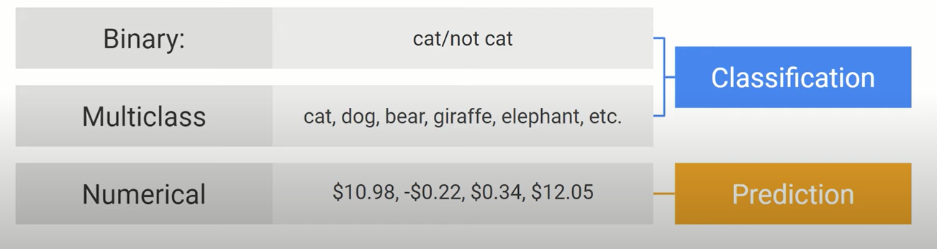
How to choose?

Slide 7
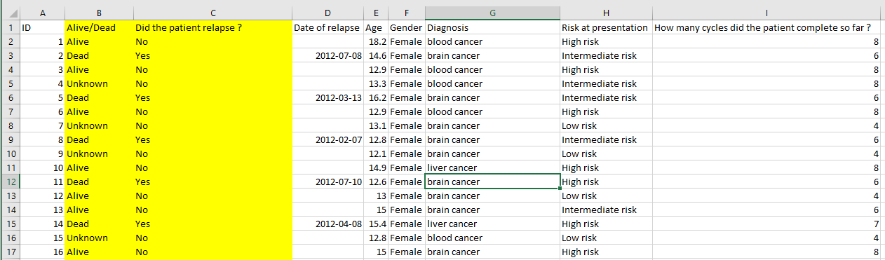
Which model?
Risk dictates chemo cycles
Notes:
<number>

Slide 8
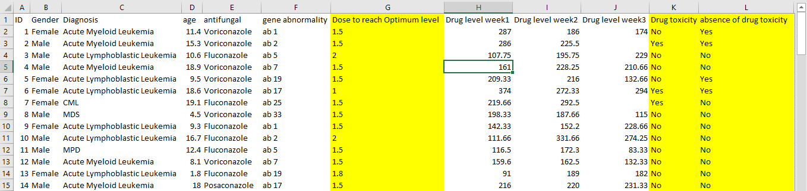
Is it safe?
Notes:
<number>

Slide 9
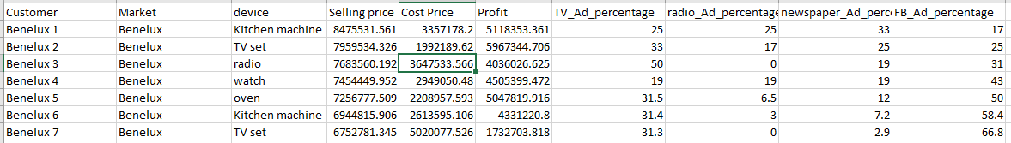
Anything wrong?

Slide 10

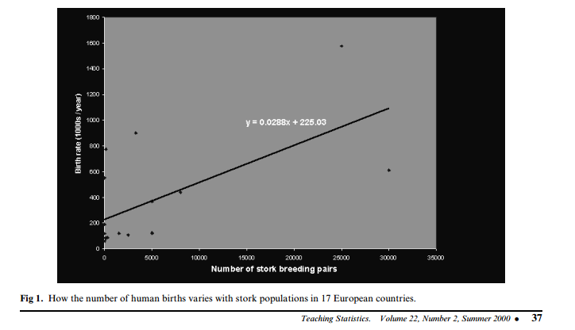

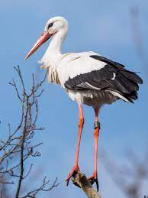
Storks Deliver Babies (p  0.008)
r = 0.62
Notes:
There is a high correlation between the number of storks in an area and the number of babies born. This was observed in the city of Copenhagen by looking at records of number of births and the number of storks over a 10-year period after World War II.1 It turns out that after the war, more people moved to Copenhagen (so more babies were born there) and more construction was going on in the city (so storks had more places, thus more storks).
<number>

Slide 11
Spurious correlations
http://www.tylervigen.com/spurious-correlations

Slide 12
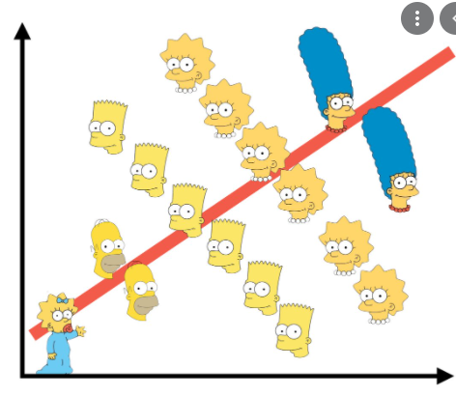
Simpsons paradox
How Can we solve it?

Slide 13
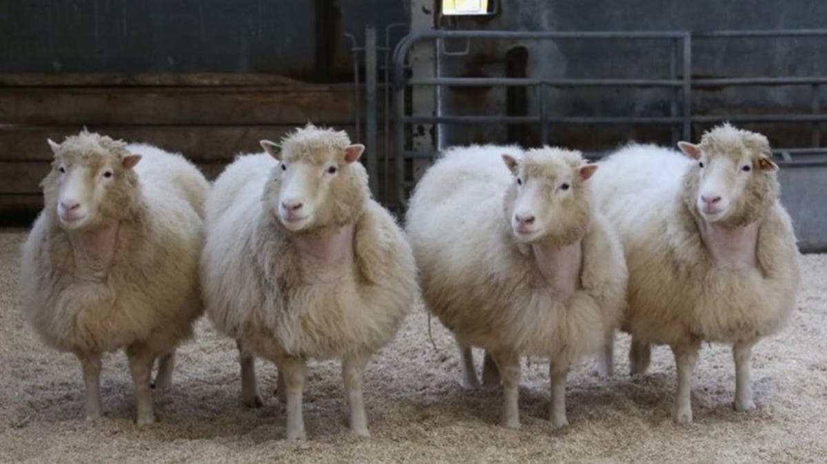
Randomization

Slide 14
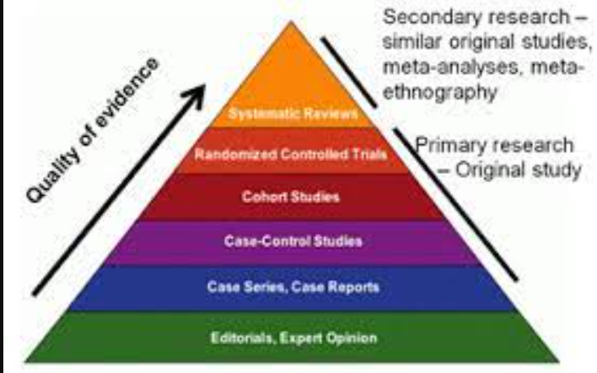
evidence

Slide 15
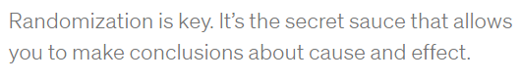
Cassie kozyrgov

Slide 16

Randomizaion Not always possible
Notes:
<number>

Slide 17

Welcome to linear regression
A partial solution
Notes:
<number>

Slide 18
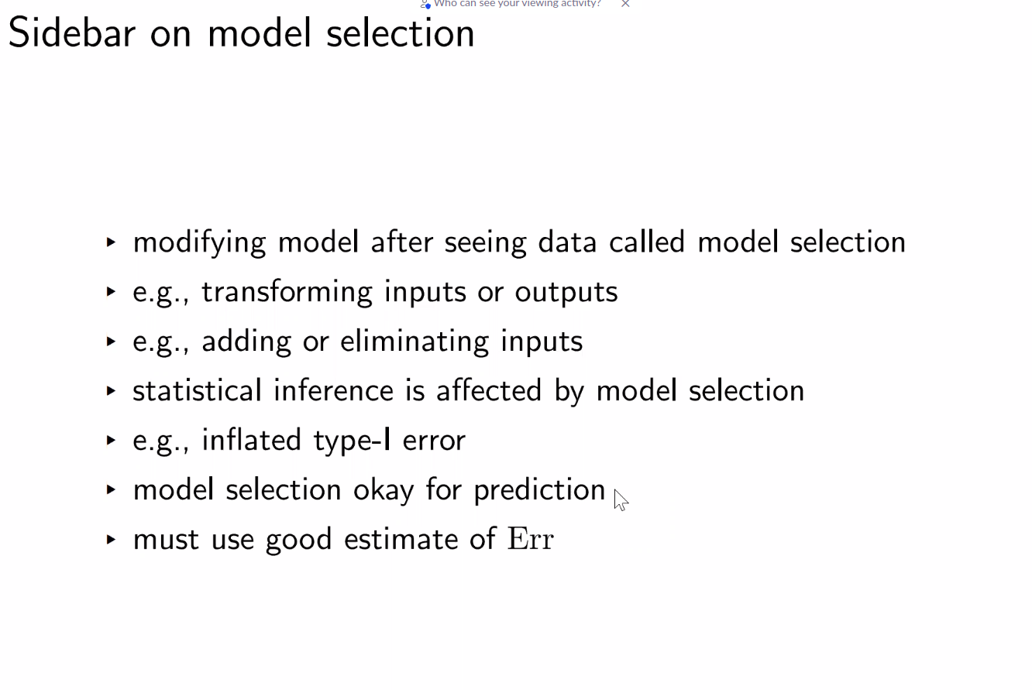
Matt shotwell presentation

Slide 19
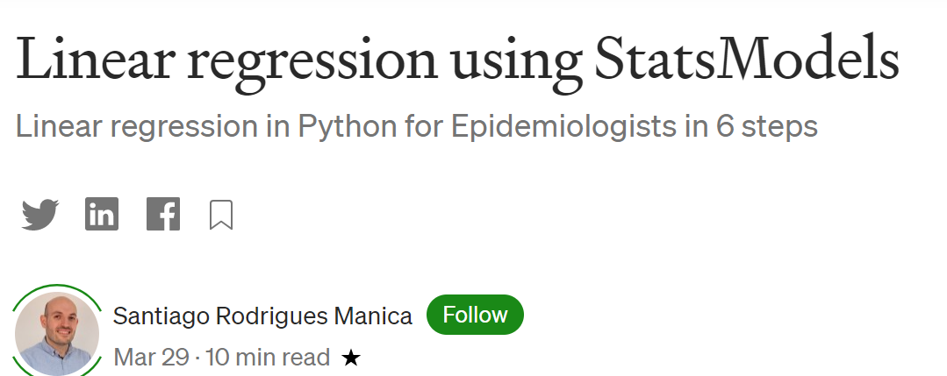
demo
Notes:
Linear regression using StatsModels | by Santiago Rodrigues Manica | EvidentEBM | Medium
https://medium.com/evidentebm/linear-regression-using-statsmodels-d0db5fef16bb
<number>

Slide 20
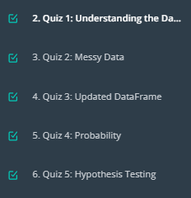
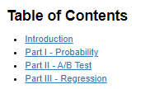
A/B testing Project

Slide 21
Part II - A/B Test
state your hypothesis
Notes:
<number>

Slide 22
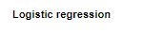
Part III - A regression approach

Slide 23
Breakout room1
https://campus.datacamp.com/courses/introduction-to-python-de9bedd8-983f-4a5b-a614-3d01d76e614e/67436?ex=1
Dataset description:
https://stat.ethz.ch/R-manual/R-devel/library/datasets/html/mtcars.html

Slide 24
Another point of view
Welcome to machine learning

Slide 25
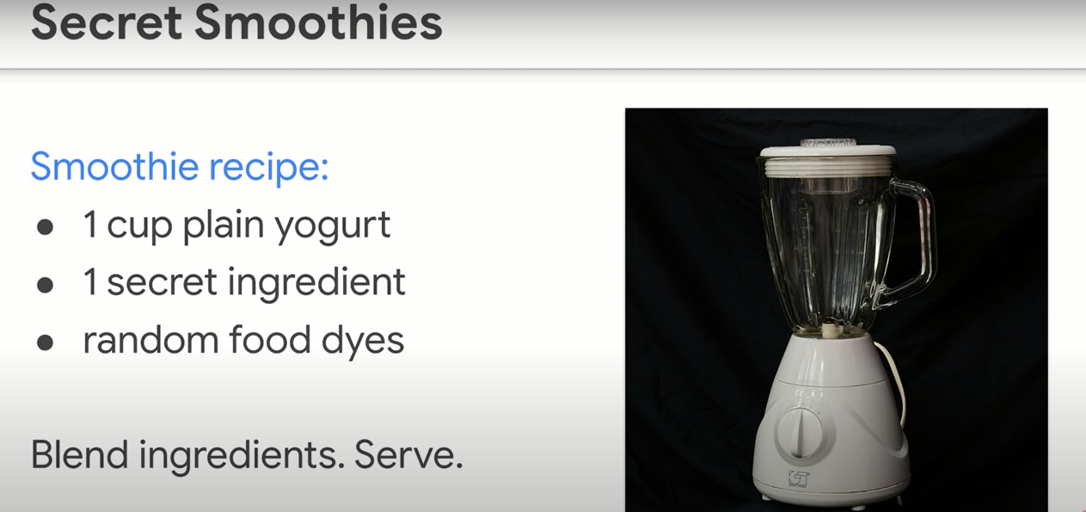
regression

Slide 26
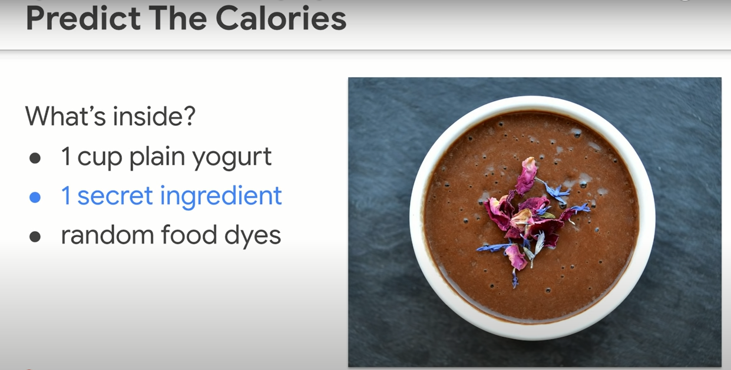
Guess!

Slide 27
Attitude of machine learning
Think carefully - perfectionism – get it right on the first shot
Give it a shot! – get it wrong – try again – ITERATE

Slide 28
Brave enough?
Let’s iterate …
Unlocking the next slide ☺

Slide 29
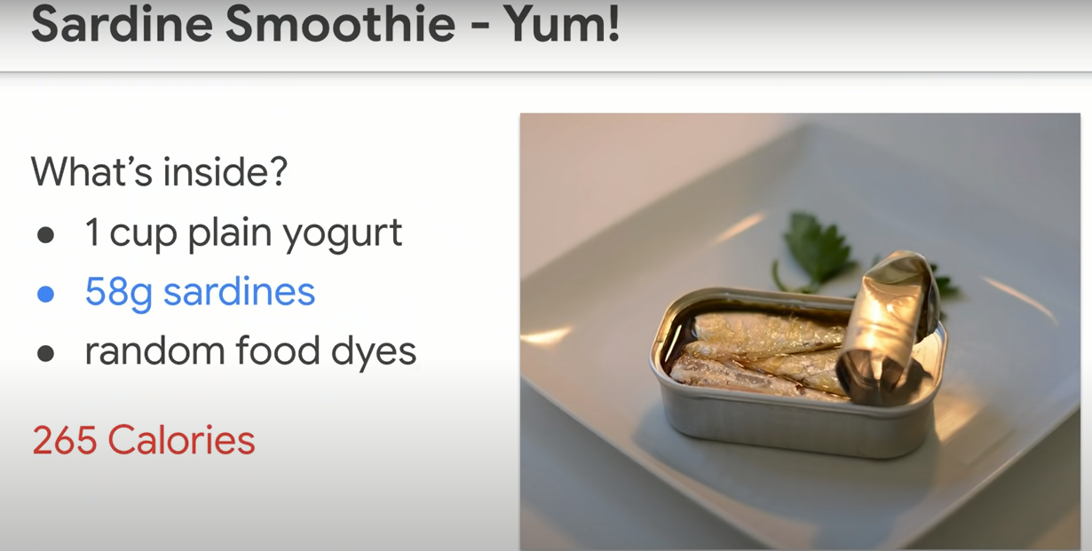

Slide 30
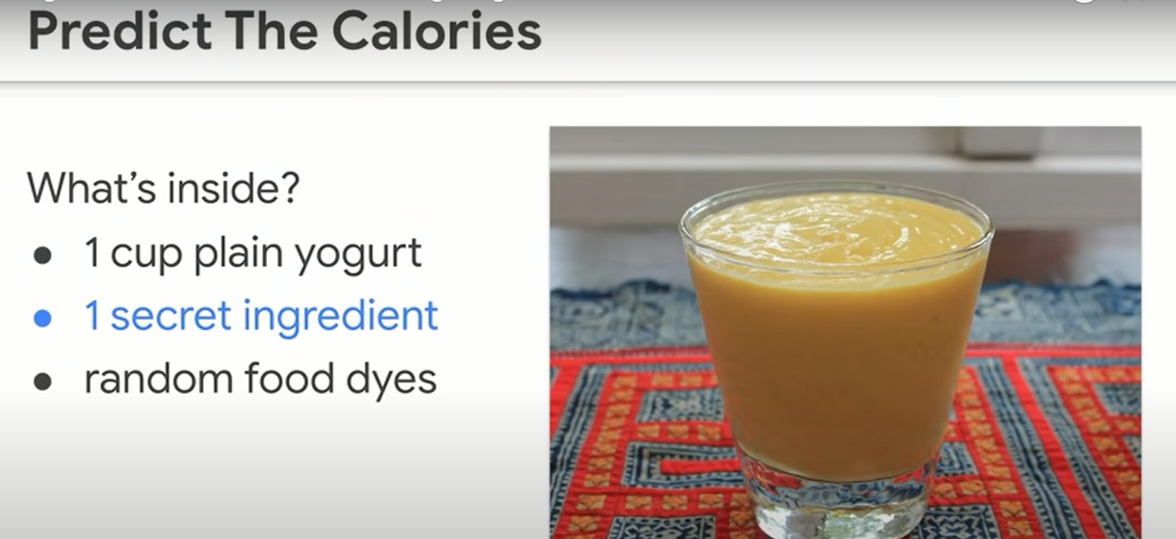
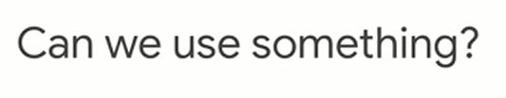
Notes:
We’ve been guessing based on no info
Can we have some info to guess based on ?
<number>

Slide 31
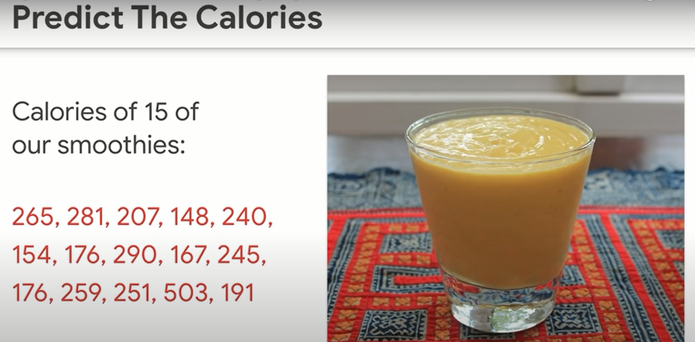
How to use the info?

Slide 32
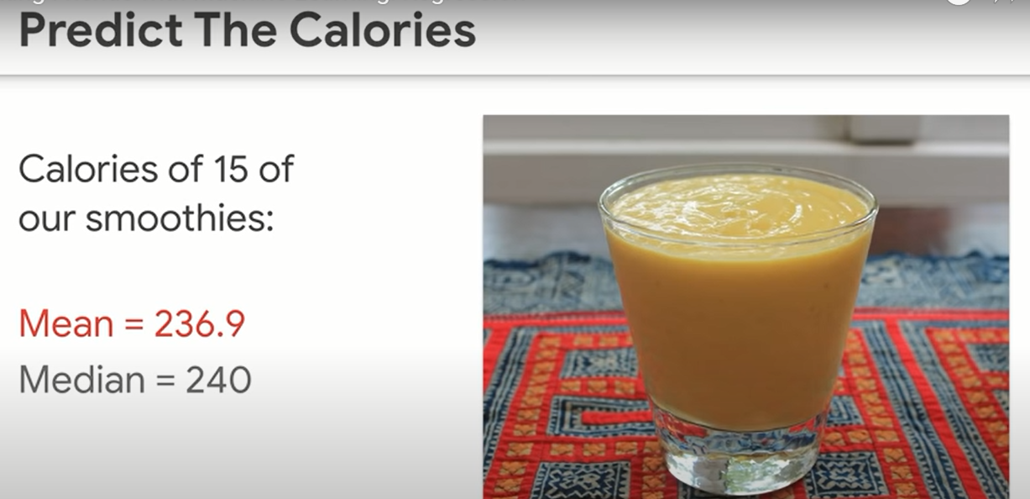
Guess now
Notes:
Notice how the guesses has narrowed now. Based on the new info
<number>

Slide 33
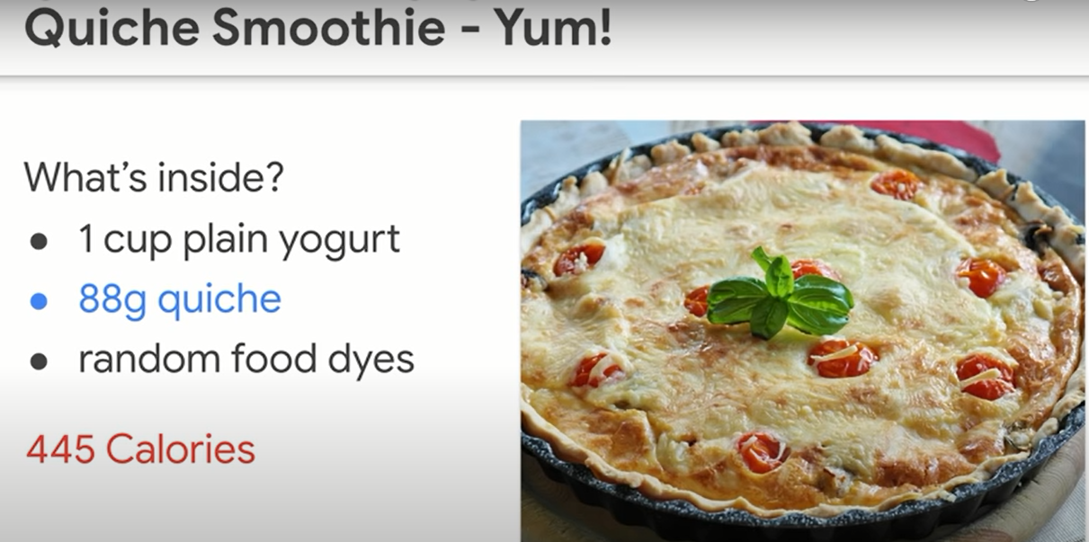
A bad guess ☹

Slide 34
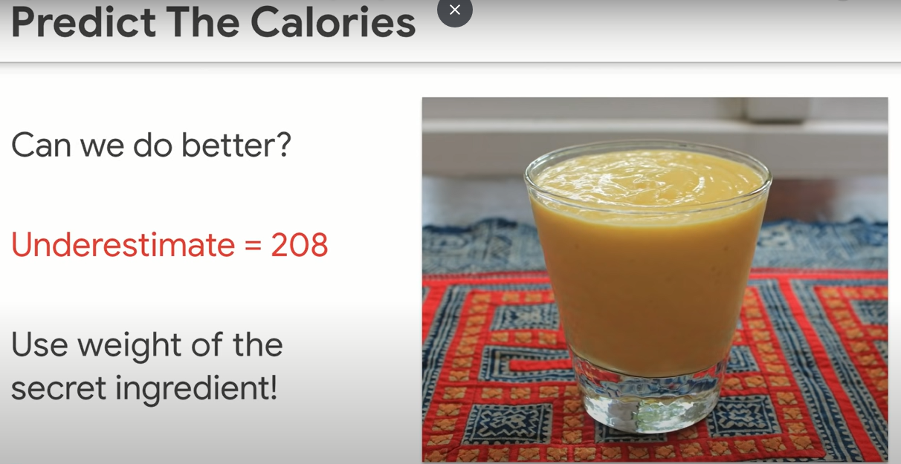

Slide 35
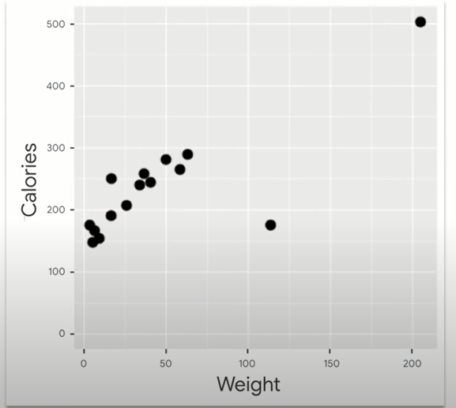
Is weight useful?

Slide 36
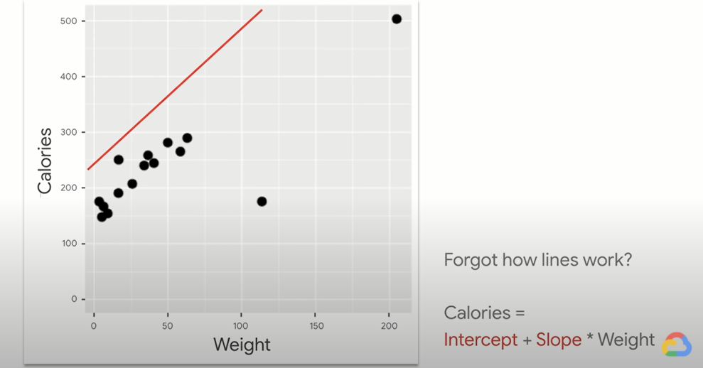
Regression: putting line through stuff

Slide 37
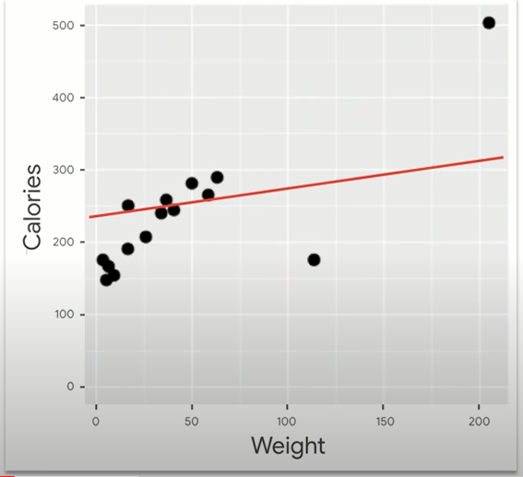
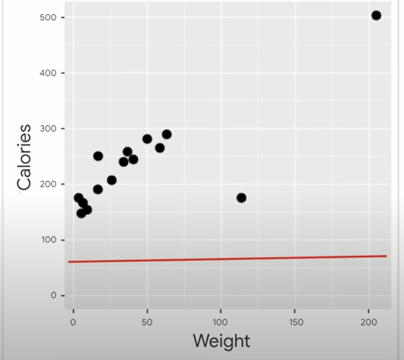

Slide 38
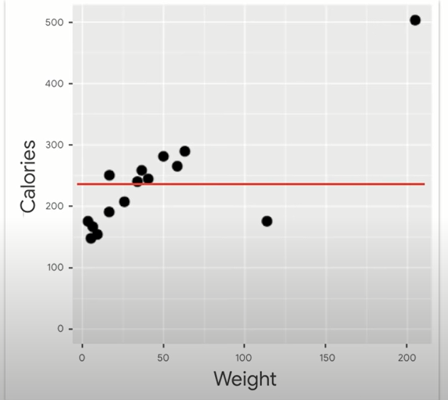
This one!
Why not?
Notes:
<number>

Slide 39
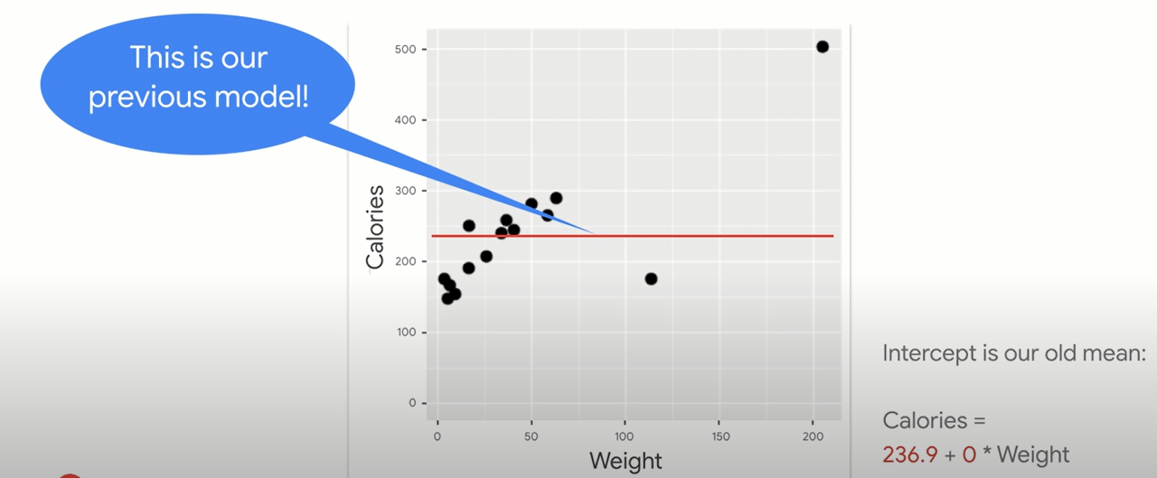
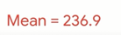
Weight is useless
Notes:
<number>

Slide 40
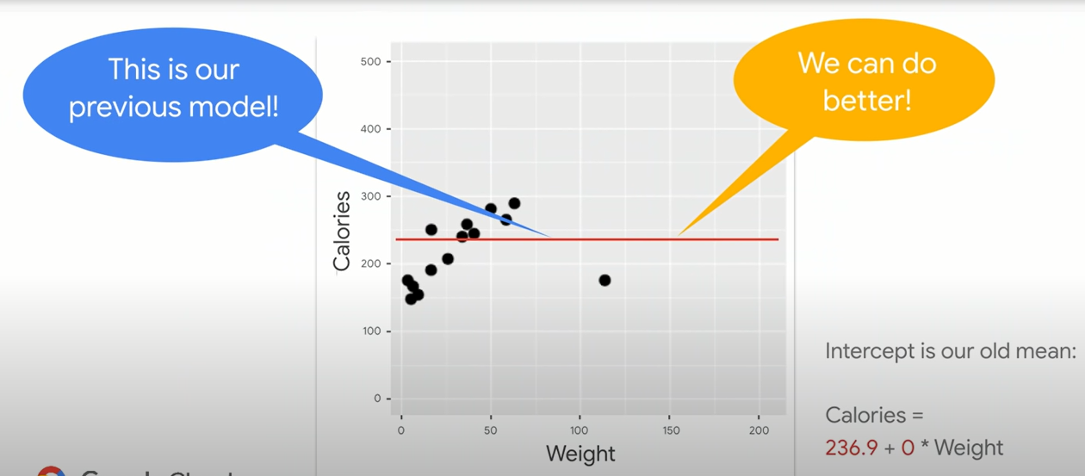
We have a feature

Slide 41
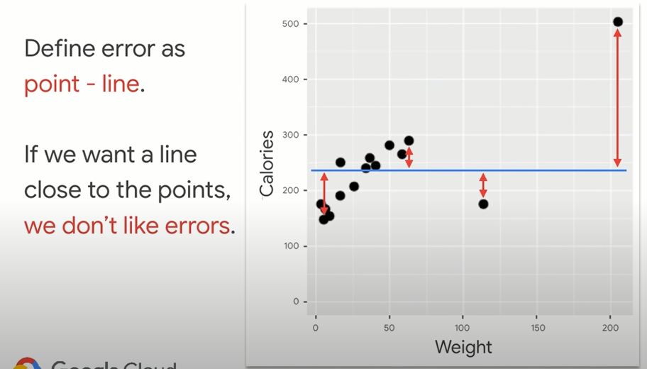
Notes:
RMSE = inversely named
Error, square it, Mean (take average), then root (sq root)
<number>

Slide 42
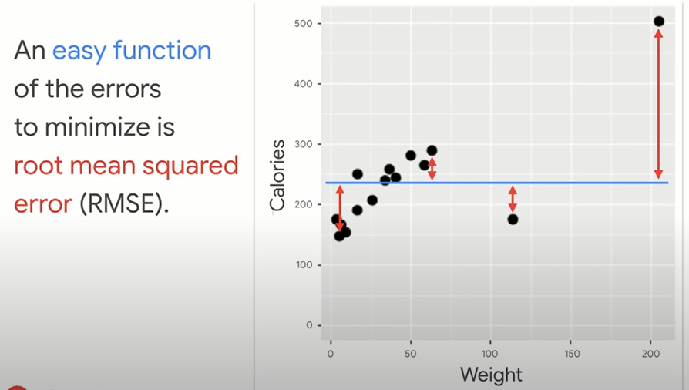
Best fit line?

Slide 43
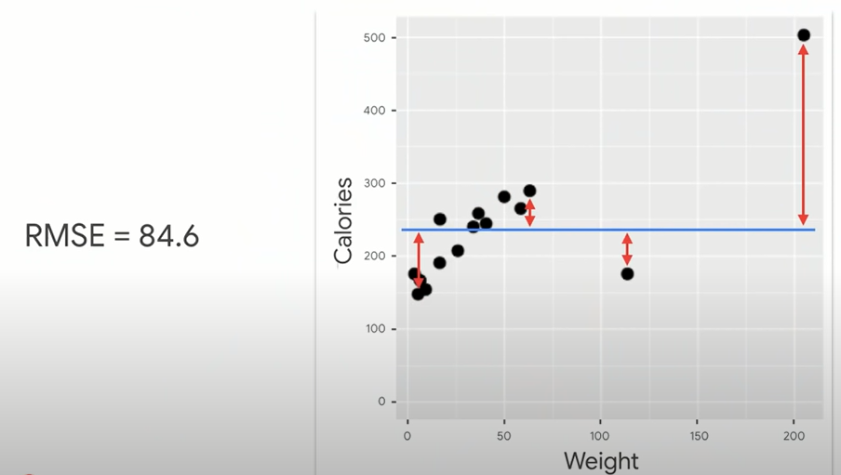

Slide 44
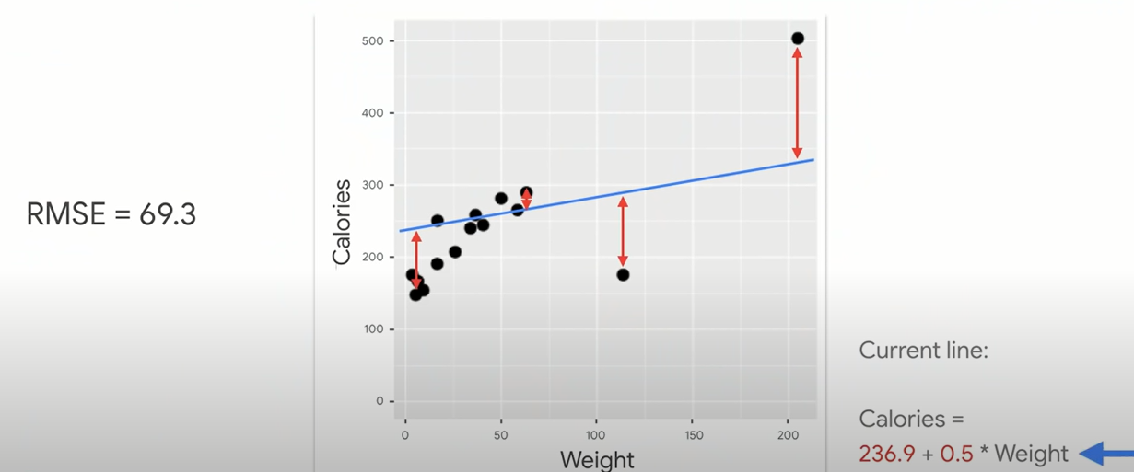

Slide 45
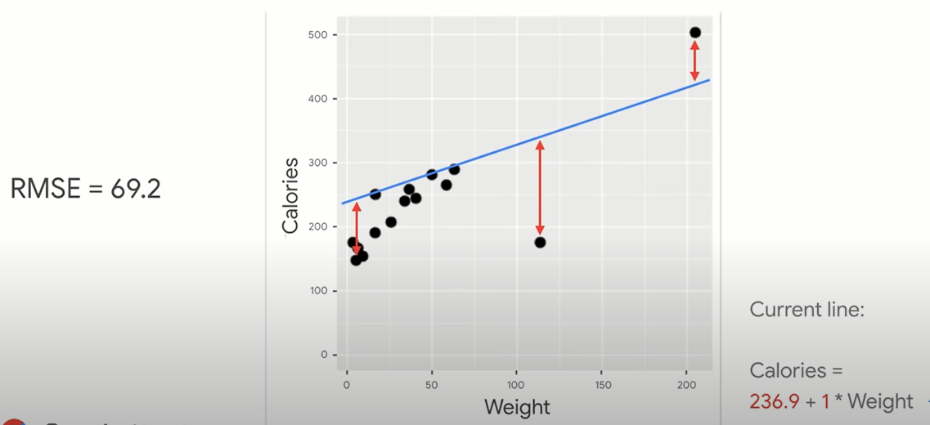

Slide 46
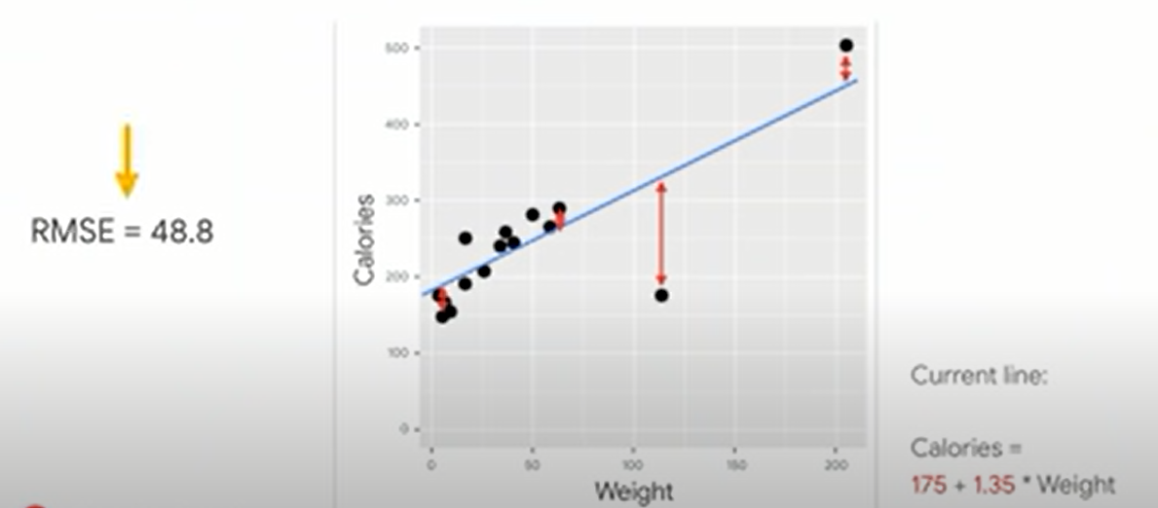

Slide 47
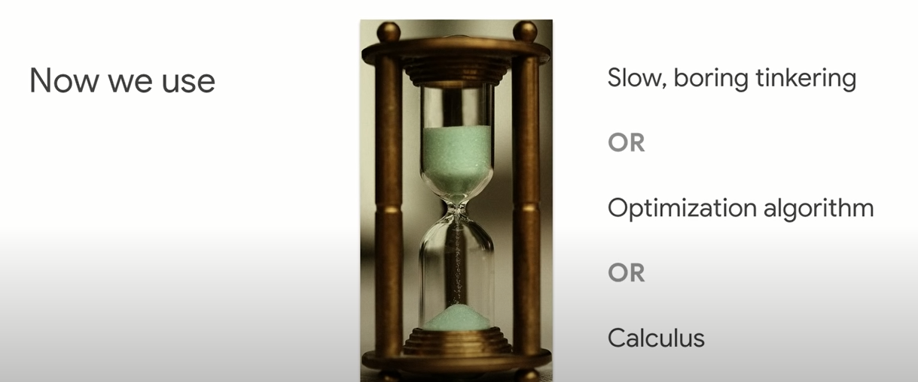

Slide 48
Heart of machine learning
Know ur score(eg. RMSE)
Play with parameters(intercept and slope) to minimize ur error

Slide 49
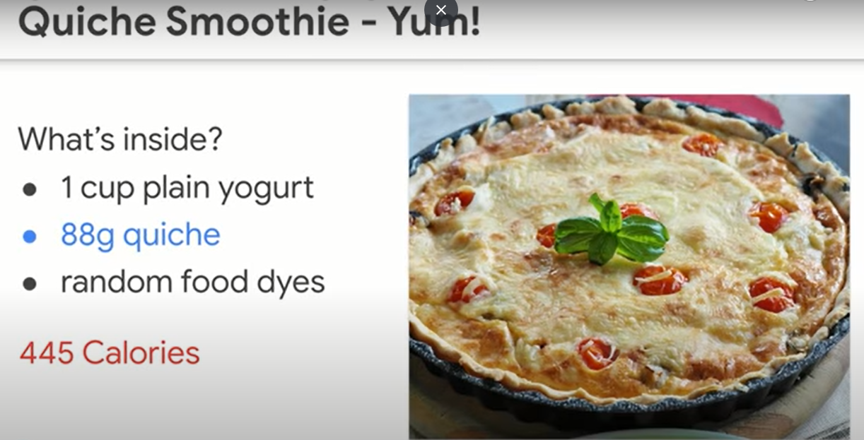

Slide 50
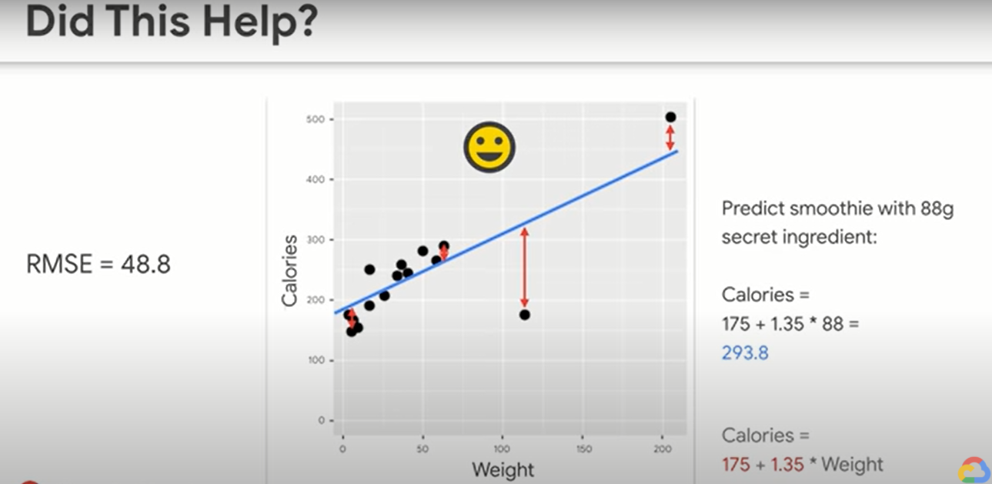
Not much

Slide 51
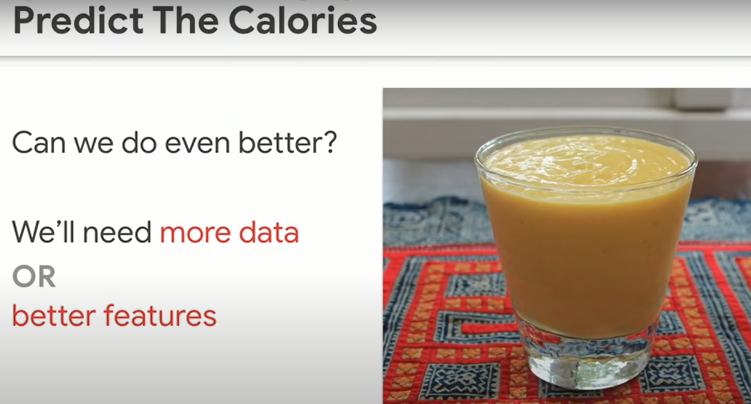

Slide 52
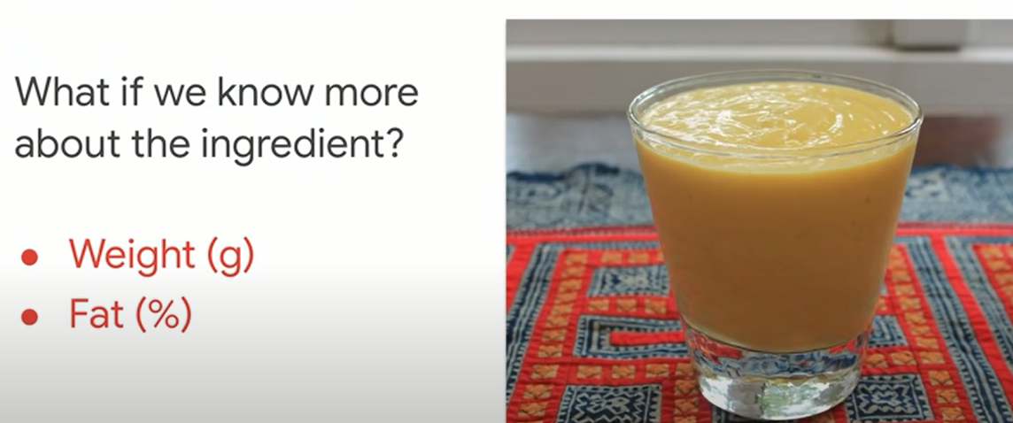

Slide 53
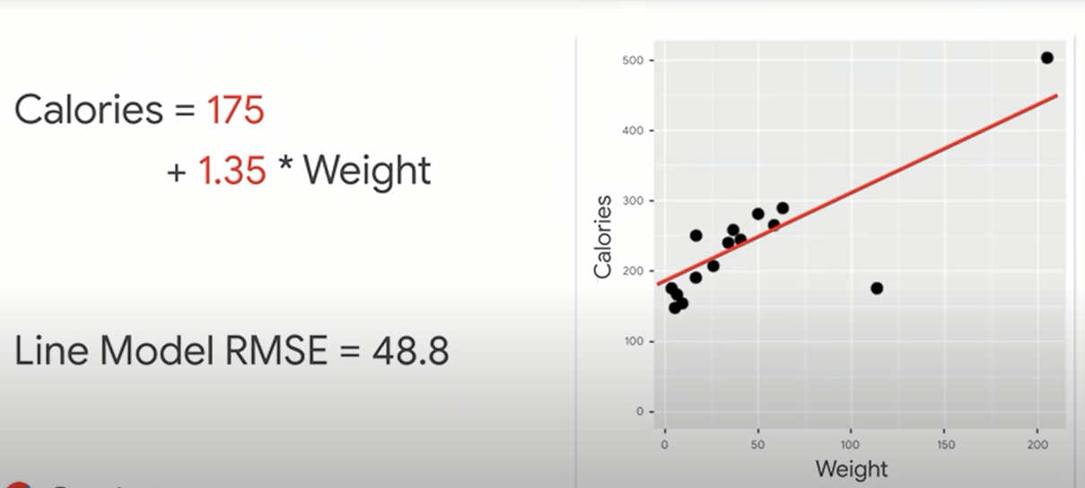
IT WAS A LINE
Statistics?
Notes:
In stats, we needed p values/ R sq adjusted R squared, etc….
Here… just optimize
<number>

Slide 54
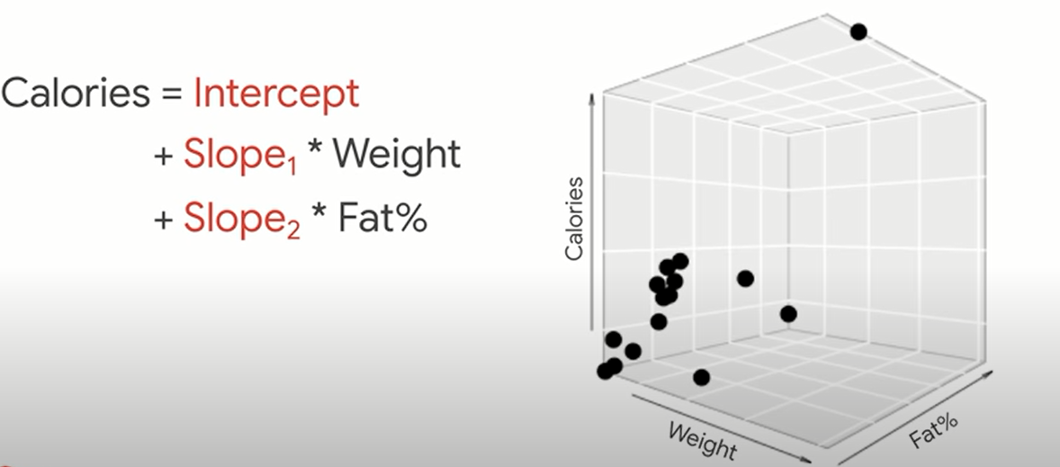
NOW A PLANE

Slide 55
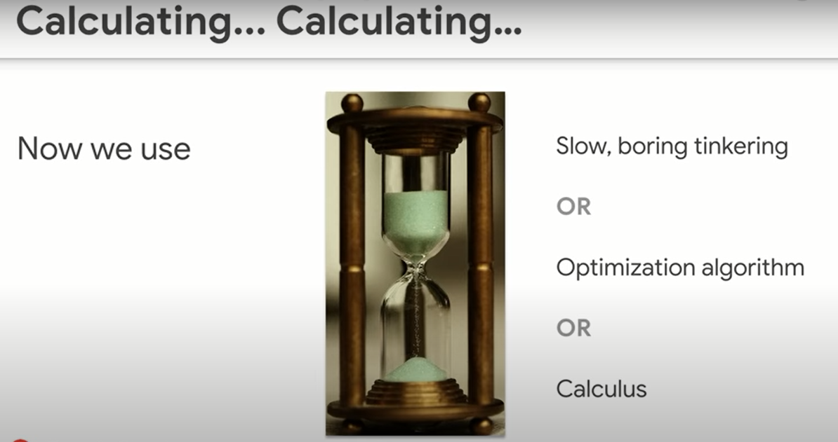

Slide 56
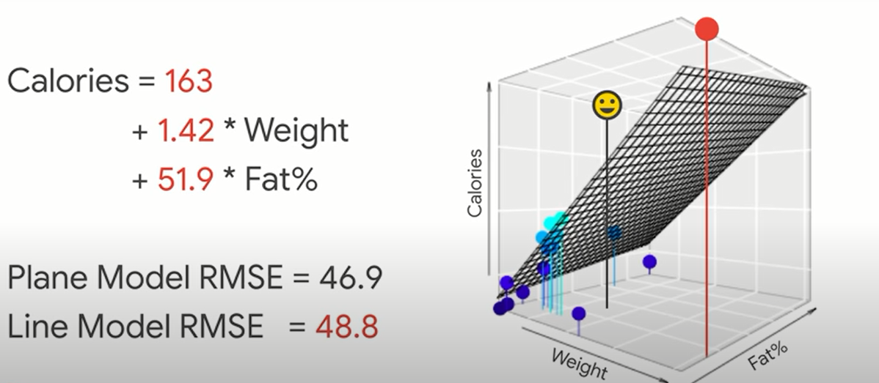
ENOUGH IMPROVEMENT?
Notes:
I added a new feature and I only get this improvement?
<number>

Slide 57
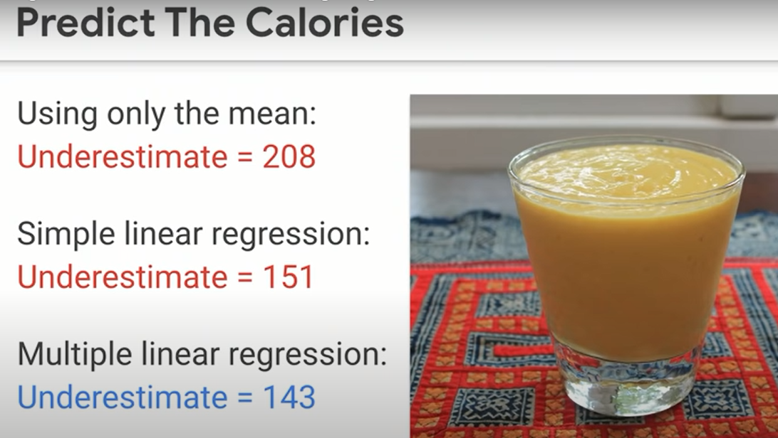

Slide 58
Machine learning pillar!
Does it take a long time to try it?
If No, then do it. Even if it’s not very justified
Notes:
That’s an essence in machine learning.
<number>

Slide 59
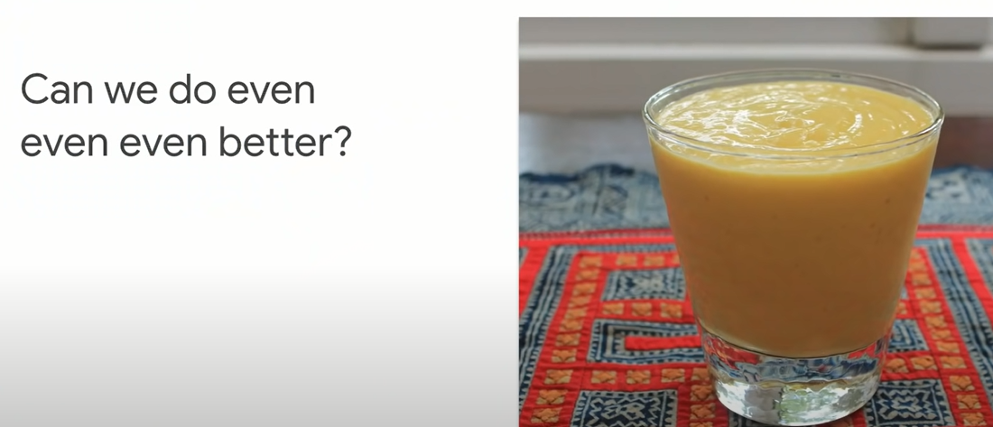

Slide 60
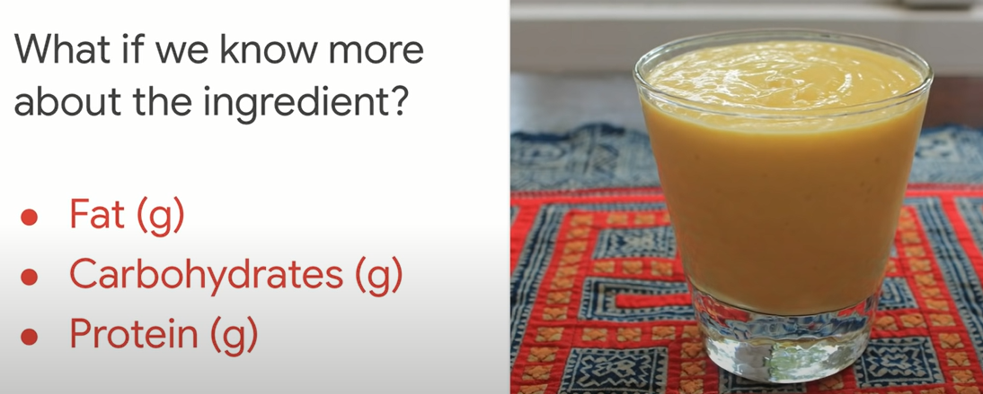
Any guesses?
Notes:
9:4:4
Magic numbers
<number>

Slide 61
9:4:4 nutrition rule
Notes:
9:4:4
Magic numbers
<number>

Slide 62

Notes:
<number>

Slide 63

9:4:4

Slide 64

Feature engineering
What’s this 143?
Notes:
<number>

Slide 65

Notes:
If we added water a secret ingredient
We get 143
<number>

Slide 66


Slide 67


Slide 68


Slide 69


Slide 70

Train – test - validate …
Notes:
As usual, our favorite bumbler forgot to buy the assigned textbook, but, luckily, he jotted down an equation from the blackboard (it’s the 90s) and now he’s got one night to learn enough to pass your exam. You’re his calculus prof in this story, by the way — I applaud your patience.
<number>

Slide 71

What he got..
No more examples [data points]
No explicit rules
Notes:
No explicit rules ( that’s the opposite of ML]
No other examples for ML to learn
<number>

Slide 72

Training
Notes:
Just like an AI algorithm, his goal is to find a data pattern that he can turn into a recipe (“model”) that successfully takes him from the input on the left of the “=” to the output on the right-hand side.
<number>

Slide 73

Found the pattern
Fits perfectly!
Go to exam?
Notes:
<number>

Slide 74

Try another example!!
Notes:
That’s exactly what validation (step 8) in machine learning is. Validation creates a safe, low-stakes opportunity for students to try their recipes on examples they haven’t studied explicitly. That’s how they get a signal about whether they’re ready for the real exam.
<number>

Slide 75

More examples before exam
Notes:
(Mr. Bean is very lucky to have a professor like you. Thank you for sending him additional examples to try in the comfort and safety of his dorm room!)
<number>

Slide 76


Tries his model

Slide 77

What now?
start over
go to the exam anyway.
Notes:
12 Steps to Applied AI. A roadmap for every machine learning… | by Cassie Kozyrkov | The Startup | Medium
https://medium.com/swlh/12-steps-to-applied-ai-2fdad7fdcdf3
If he chooses to start over, he might go back to training (step 6) and search for new patterns in the data he already has (that single paltry datapoint) or he might go even further back and consider adjusting the data he’s working with (if it were me, I’d be begging you for a bunch of additional examples, which would mean going all the way back to step 2 in my guide).
Students (and ML/AI engineers) are allowed to bounce back and forth between looking for patterns and validating their new recipes as much as they like. (But don’t stay up all night studying!)
<number>

Slide 78

3 am
Notes:
Finally, at 3 AM, Mr. Bean found a pattern that works correctly on all the validation examples you’ve given him.
<number>

Slide 79

Notes:
You’re practically roaring, “Of course not!!!!”
<number>

Slide 80

Testing phase in ML/AI

Slide 81

Fits perfectly!
Notes:
For all you know, he might have hacked together a crazy recipe that overfits, er, contorts itself to fit those specific examples he has been staring at all night. Perhaps he has just memorized all the answers and that’s his recipe — looking them up from memory. There’s no guarantee he understands anything general enough to handle new problems.
<number>

Slide 82

No trust
How well he performs on new tasks

Slide 83

Notes:
So, is Mr. Bean’s best good enough? Should you give him a pass to go on to the next step (where you productionize him for mathematics in the wild) or should you delicately suggest he switch majors?
<number>

Slide 84

Fails on testing? Game over…

Slide 85

Notes:
Training, validation, and test phases in AI — explained in a way you’ll never forget | by Cassie Kozyrkov | Towards Data Science
https://towardsdatascience.com/training-validation-and-test-phases-in-ai-explained-in-a-way-youll-never-forget-744be50154e8
<number>

Slide 86



Notes:
If all you care about is failing unworthy students, you don’t need a validation phase. All you need is testing. Poor Mr. Bean trains, finds a pattern (it was a stupid pattern), rushes to your exam, fails the exam, and gets kicked out of the math major. You caught and executed an ignoramus. Great job!
<number>

Slide 87
Testing: Only the worthy should pass!
What about helping students to improve?
Notes:
<number>

Slide 88
Testing: Only the worthy should pass!
Validation: helping students improve
Notes:
<number>

Slide 89

The question
Notes:
If you really care about your students, it would be sad to find out that their attempts at a recipe are silly only after it’s too late to help them. (On the final exam itself.) What are you, a teacher or an executioner?
<number>

Slide 90

Notes:
How to be an AI idiot. 7 ways to royally mess up your machine… | by Cassie Kozyrkov | Towards Data Science
https://towardsdatascience.com/how-to-be-an-ai-idiot-8559c65d91a8
<number>

Slide 91
Breakout room 2
https://learn.datacamp.com/projects/558

Slide 92
Smf
Easy peasy
Reorder categories
Notes:
python - Pandas - change the order of levels of factor-type object - Stack Overflow
https://stackoverflow.com/questions/38023881/pandas-change-the-order-of-levels-of-factor-type-object
<number>

Slide 93


04/10/2022
Source:
<number>

Slide 94

04/10/2022
Source:
<number>

Slide 95

04/10/2022
Source:
<number>

Slide 96

04/10/2022
Source:
<number>

Slide 97
Shiny experience
https://gallery.shinyapps.io/simple_regression/

Slide 98

NO FREE LUNCH THEOREM
Notes:
A model is a simplified version of the observations. The simplifications are meant to discard the superfluous details that are unlikely to generalize to new instances. To decide what data to discard and what data to keep, you must make assumptions. For example, a linear model makes the assumption that the data is fundamentally linear and that the distance between the instances and the straight line is just noise, which can safely be ignored.
In a famous 1996 paper,¹¹ David Wolpert demonstrated that if you make absolutely no assumption about the data, then there is no reason to prefer one model over any other. This is called the No Free Lunch (NFL) theorem. For some datasets the best model is a linear model, while for other datasets it is a neural network. There is no model that is a priori guaranteed to work better (hence the name of the theorem). The only way to know for sure which model is best is to evaluate them all. Since this is not possible, in practice you make some reasonable assumptions about the data and evaluate only a few reasonable models. For example, for simple tasks you may evaluate linear models with various levels of regularization, and for a complex problem you may evaluate various neural networks.
https://learning.oreilly.com/library/view/hands-on-machine-learning
<number>

Slide 99
models are helpful because they filter out noise (a map of New York is helpful for navigating the city in part because of all of the detail it omits). But an over-simplified model can also filter out some signal too, so in a data-rich and high signal-to-noise environment, you would not want to use an unnecessarily small model. Simplicity, however, can be a virtue when signal-to-noise is low, where the benefit of filtering out noise might outweigh the cost of missing some signal.
Notes:
Can machines learn finance
Article from jesse blocher
In asset management, one can begin to tackle the low signal-to-noise problem by bringing economic theory to describe some aspects of the data, complemented by machine learning tools to capture aspects of the data for which theory is silent. Some relevant academic examples are Kelly et al. (2017), Kelly et al. (2018), and Gu, Kelly, and Xiu (2019), which begin with a basic economic structure and introduce machine learning in only one aspect of the model
<number>

Slide 100

Datacamp supervised learning with sickit learn
Notes:
Answer : 1 .. Up or down
<number>

Slide 101

Notes:
Bike store
<number>

Slide 102
Lasso and ridge regression
Get a better source than the datacamp course
Notes:
Lasso used the L1 penalty to regularize, while ridge used the L2 penalty. There is another type of regularized regression known as the elastic net. In elastic net regularization, the penalty term is a linear combination of the L1 and L2 penalties:
a∗L1+b∗L2
In scikit-learn, this term is represented by the 'l1_ratio' parameter: An 'l1_ratio' of 1 corresponds to an L1 penalty, and anything lower is a combination of L1 and L2.
<number>

Slide 103

Imbalance
Notes:
Which accuracy measure should we use ?
How good is your model? | Python
https://campus.datacamp.com/courses/supervised-learning-with-scikit-learn/fine-tuning-your-model?ex=1
<number>

Slide 104


A good model?
Why not?

Slide 105

SOLUTION

Slide 106


RECALL

Slide 107


Slide 108


Slide 109

Notes:
For all arguments in sickit learn, the first is true label,
Second is the prediction
What is support ?
I think it the number of patients within each group
Yep, that’s true
Check the confusion matrix
<number>

Slide 110


logistic regression
Odds vs probability

Slide 111


Slide 112


Slide 113

assymetry

Slide 114

Taking the log

Slide 115

Notes:
(1) StatQuest: Odds and Log(Odds), Clearly Explained!!! - YouTube
https://www.youtube.com/watch?v=ARfXDSkQf1Y
<number>

Slide 116

Odds ratio

Slide 117

Notes:
(1) StatQuest: Odds Ratios and Log(Odds Ratios), Clearly Explained!!! - YouTube
https://www.youtube.com/watch?v=8nm0G-1uJzA
<number>

Slide 118

Notes:
(1) Logistic Regression Details Pt1: Coefficients - YouTube
https://www.youtube.com/watch?v=vN5cNN2-HWE
<number>

Slide 119

Notes:
(1) Logistic Regression Details Pt 2: Maximum Likelihood - YouTube
https://www.youtube.com/watch?v=BfKanl1aSG0
<number>

Slide 120

Notes:
(1) Logistic Regression Details Pt 3: R-squared and p-value - YouTube
https://www.youtube.com/watch?v=xxFYro8QuXA&t=303s
<number>

Slide 121
Logistic regression
Cut-off of 0.5
Same of KNN
But we can modify the cut-off

Slide 122

ROC
Notes:
Threshould = 0
TP = FP = 1
Bad!!
<number>

Slide 123

Notes:
TP = FP = 0
BAD!!
<number>

Slide 124


ROC

Slide 125

Notes:
Roc-curve returns 3 arrays, that’s why we capture them in fpr, tpr and thresholds
Then we plot the fpr and tpr
Predict_proba because we are conducting ROC. We are not interested in the final classification
We are interested in the prediction probability
It returnes two arrays for the prediction of response being 0 or 1
We are interested in the response being 1
most classifiers in scikit-learn have a .predict_proba() method which returns the probability of a given sample being in a particular class.
<number>

Slide 126


Precision recall curve
Notes:
Msh fahem raqam 3
<number>

Slide 127


Notes:
Logreg has a hyperparameter C
It’s the inverse of regularization parameter alpha
The higher C, the higher the overfitting
A hyperparameter is a parameter of a learning algorithm (not of the model).
<number>

Slide 128

Overfitting
Notes:
Say you are visiting a foreign country and the taxi driver rips you off. You might be tempted to say that all taxi drivers in that country are thieves. Overgeneralizing is something that we humans do all too often, and unfortunately machines can fall into the same trap if we are not careful. In Machine Learning this is called overfitting: it means that the model performs well on the training data, but it does not generalize well.
<number>

Slide 129


Slide 130


Slide 131


Slide 132


Slide 133
Randomized search CV
Notes:
Note that RandomizedSearchCV will never outperform GridSearchCV. Instead, it is valuable because it saves on computation time.
<number>

Slide 134

Holding out a test set

Slide 135
A/B testing case study

Slide 136


Slide 137


Slide 138
Visualize the correlation
https://statistics.calpoly.edu/shiny

Slide 139

Guess the correlation

Slide 140

Solution
Notes:
2. End-to-End Machine Learning Project - Hands-On Machine Learning with Scikit-Learn, Keras, and TensorFlow, 2nd Edition
https://learning.oreilly.com/library/view/hands-on-machine-learning/9781492032632/ch02.html
Also, this shows examples where the correlation coefficient is equal to 1 or –1; notice that this has nothing to do with the slope. For example, your height in inches has a correlation coefficient of 1 with your height in feet or in nanometers.
<number>

Slide 141
Sample size and statistical significance, correlation coefficient
The minimum correlation coefficient that will be statistically significant for various sample sizes. Calculated using the approximation,
Sample Size | Minimum correlation coefficient that will be statistically significant, p<.05
10 | 0.63
100 | 0.20
1000 | 0.06
10,000 | 0.02
100,000 | 0.006
1,000,000 | 0.002
Sainani KL. Clinical versus statistical significance. PM&R. 2012;4:442-5.
Notes:
Statistical significance tells you that the correlation you observed is not likely due to chance, but does not tell you anything about the strength of the association.
<number>

Slide 142
Example: between-patient comparison
Results from a hypothetical trial in which 50 subjects were randomized to receive active drug (n=25) or placebo (n=25) in both eyes.
Analysis | N (%) of eyes improving in the control group | N (%) of eyes improving in the treatment group | p-value
Assuming eyes are independent* | 17/50 (34%) | 27/50 (54%) | .046
Correcting for within-subject correlation** | 17/50 (34%) | 27/50 (54%) | .11
*Data were analyzed with unconditional logistic regression.
**Data were analyzed using a generalized estimating equation, correcting for within-subject correlation.
Reprinted from Table 3 of: Sainani K. The importance of accounting for correlated observations. PM&R 2010 Sep;2:858-61.
Notes:
When correlated, it is about 8 patients in comparison with 13 patients who have responded.
Simply the idea is that when u are having eye drops, it is not likely that one eye would respond to treatment, however the other won’t ( if we are treating inflammation)
<number>

Slide 143

Notes:
If the class helped, then that’s causation
<number>

Slide 144

Teaser...
Notes:
Can having a lighter with u increase ur risk of developing lung cancer
<number>

Slide 145


Correlation vs causality
Direction
3rd variable
Partial correlation ?? Adjustment ?
Notes:
<number>

Slide 146

spearmen
Non parametric
Ranks then pearson
Similar equation
Notes:
<number>

Slide 147


Kendall tau
Non parametric
small data & tied ranks.
Kendall better than spearmen
more accurate generalizations from Kendall’s statistic than from Spearman’s

Slide 148


Biserial and point-biserial correlations
point-biserial correlation coefficient (rpb)
biserial correlation coefficient (rb)
Huge difference in calculations…!
Notes:
The difference is that the point-biserial correlation is used when the dichotomous variable is a true or discrete dichotomy. He either goes to jail or not.
Biserial is for the exam test, the person may succeed with 80% or 50%. The dichotomous variable is continuous
<number>

Slide 149
https://istats.shinyapps.io/Association_Quantitative/

Slide 150


Slide 151

Prediction
In correlation, the two variables are treated as equals. In regression, one variable is considered independent (=predictor) variable (X) and the other the dependent (=outcome) variable Y.
Notes:
<number>

Slide 152
What is ordinary least squares?
What is ordinary?
Notes:
Computing the root of a sum of squares (RMSE) corresponds to the Euclidean norm: this is the notion of distance you are familiar with. It is also called the ℓ₂ norm, noted ∥ · ∥₂ (or just ∥ · ∥).
Computing the sum of absolutes (MAE) corresponds to the ℓ₁ norm, noted ∥ · ∥₁. This is sometimes called the Manhattan norm because it measures the distance between two points in a city if you can only travel along orthogonal city blocks.
The higher the norm index, the more it focuses on large values and neglects small ones. This is why the RMSE is more sensitive to outliers than the MAE. But when outliers are exponentially rare (like in a bell-shaped curve), the RMSE performs very well and is generally preferred.
Linear models using ordinary least squares, in particular, are not very robust. That is, large outliers may greatly change our results. There are techniques to combat this - largely known as regularization techniques.
2. End-to-End Machine Learning Project - Hands-On Machine Learning with Scikit-Learn, Keras, and TensorFlow, 2nd Edition
https://learning.oreilly.com/library/view/hands-on-machine-learning/9781492032632/ch02.html
<number>

Slide 153

Notes:
What are other options ?
<number>

Slide 154


Notes:
When is it ok to remove the intercept in a linear regression model? - Cross Validated
https://stats.stackexchange.com/questions/7948/when-is-it-ok-to-remove-the-intercept-in-a-linear-regression-model
<number>

Slide 155
Hypothesis testing for linear regression
Notes:
However, the hypothesis test for each x-variable is a test of if that population slope is equal to zero vs. an alternative where the parameter differs from zero. Therefore, if the slope is different than zero (the alternative is true), we have evidence that the x-variable attached to that coefficient has a statistically significant linear relationship with the response. This in turn suggests that the x-variable should help us in predicting the response (or at least be better than not having it in the model).
<number>

Slide 156

What about adjusted R squared?

Slide 157


Slide 158

Coefficient of determination
Adjusted R squared
N obs ~ 20 times > variables under study
Notes:
High R squared maybe due to over fitting or violate assumptions
Low R squared in a complex problem maybe useful
<number>

Slide 159


Slide 160
Is R-squared Useless? | University of Virginia Library Research Data Services + Sciences
https://data.library.virginia.edu/is-r-squared-useless/
36-401, Modern Regression (2015)
http://www.stat.cmu.edu/~cshalizi/mreg/15/
using cross-validation can assist us with validating any measure that helps us understand the fit of a model to our data. HOW?
Notes:
Many feel that Rsquared isn't a great measure (which is possibly true), but I would argue that using cross-validation can assist us with validating any measure that helps us understand the fit of a model to our data. Here, you can find one such argument explaining why one individual doesn't care for Rsquared.
<number>

Slide 161

Notes:
Machine Learning Fundamentals: Cross Validation - YouTube
https://www.youtube.com/watch?v=fSytzGwwBVw
<number>

Slide 162

Solution ?
Notes:
<number>

Slide 163

Why ???
Notes:
## To show the line that was fit I used the following code from
## https://plot.ly/matplotlib/linear-fits/
## It isn't the greatest fit... but it isn't awful either
Why did we use plotly?
<number>

Slide 164


Slide 165

Notes:
Get a good example
<number>

Slide 166

TEASER
“Middle-aged and older men with high levels of vitamin D in their blood were mentally quicker than their peers, researchers report.”
“The findings are some of the strongest evidence yet of such a link because of the size of the study and because the researchers accounted for a number of lifestyle factors believed to affect mental ability when older, Lee said.”

Slide 167
Hypothetical data loosely based on [1]; cross-sectional study of 100 middle-aged and older European men.
Cognitive function is measured by the Digit Symbol Substitution Test (DSST).

Slide 168

Sample data: vitamin D (n=100)
Right-skewed!
Mean= 63 nmol/L
Standard deviation = 33 nmol/L

Slide 169

Distribution of DSST
Normally distributed
Mean = 28 points
Standard deviation = 10 points

Slide 170
Multiple linear regression - control for confounders - improve predictions - test for interactions between predictors (effect modification)

Slide 171


Slide 172
What if age is a confounder here?
Older men have lower vitamin D
Older men have poorer cognition
“Adjust” for age by putting age in the model:
DSST score = intercept + slope₁xvitamin D + slope₂ xage

Slide 173
Multivariate regression results:
Parameter Estimates
Variable | Label | DF | Parameter Estimate | Standard Error | t Value | Pr > |t|
Intercept | Intercept | 1 | 53.29472 | 6.31183 | 8.44 | <.0001
age |  | 1 | -0.45689 | 0.07647 | -5.97 | <.0001
d | Vitamin D, per 10 nmol/L | 1 | 0.03944 | 0.04398 | 0.09 | 0.9289

Slide 174
Evidence of confounding
Unadjusted beta: 1.5
Age-adjusted beta: .039
Beta changed by 97.4%!

Slide 175
Confounding rule of thumb
Look for changes in beta (more than 10% change)
Do not judge by p-values!
Notes:
If a potential confounder changes the beta coefficient between the predictor of interest and the outcome variable by more than 10%, then it is considered a confounder.
Do not judge confounders by their effect on p-values!

Slide 176
Key terms
Confounding variable (confounder)
Adjustment

Slide 177
04/10/2022
Source:
<number>

Slide 178



Notes:
Check chapter 3
Notice. It’s recommended in python course, while it’s in R
<number>

Slide 179


Notes:
Machine-Learning-Books-With-Python/Introduction to Statistical Learning at master · tdpetrou/Machine-Learning-Books-With-Python
https://github.com/tdpetrou/Machine-Learning-Books-With-Python/tree/master/Introduction%20to%20Statistical%20Learning
<number>

Slide 180
Linear algebra refresher
Datacamp linear algebra
Linear algebra 3blue1brown
Notes:
Linear Algebra | Khan Academy
https://www.khanacademy.org/math/linear-algebra
Linear Algebra Refresher Course - Udacity
https://classroom.udacity.com/courses/ud953
<number>

Slide 181

When fitting simple linear regression

Slide 182



Slide 183

Notes:
matrix_OLS_NYU_notes.pdf
https://web.stanford.edu/~mrosenfe/soc_meth_proj3/matrix_OLS_NYU_notes.pdf
<number>

Slide 184
Holding all variables constant
El gard fel geesh ☺
Wa2af kol el ta3amolat 3shan ne3mel gard

Slide 185

Notes:
Why drop one of the three columns
Degree of freedom
Know more
FAQ: What does it mean for a non-square matrix to be full rank?
(Contributed by Richard Murray, 17 May 2008)
A matrix is full row rank when each of the rows of the matrix are linearly independent and full column rank when each of the columns of the matrix are linearly independent. For a square matrix these two concepts are equivalent and we say the matrix is full rank if all rows and columns are linearly independent. A square matrix is full rank if and only if its determinant is nonzero.
For a non-square matrix with rows and columns, it will always be the case that either the rows or columns (whichever is larger in number) are linearly dependent. Hence when we say that a non-square matrix is full rank, we mean that the row and column rank are as high as possible, given the shape of the matrix. So if there are more rows than columns (), then the matrix is full rank if the matrix is full column rank.
FAQ: What does it mean for a non-square matrix to be full rank? - FBSwiki
https://www.cds.caltech.edu/~murray/amwiki/index.php/FAQ:_What_does_it_mean_for_a_non-square_matrix_to_be_full_rank%3F
<number>

Slide 186

Notes:
(1) Inverse matrices, column space and null space | Chapter 7, Essence of linear algebra - YouTube
https://www.youtube.com/watch?v=uQhTuRlWMxw
<number>

Slide 187

Notes:
Know more
This happened when I fitted the dummy variable with all levels
<number>

Slide 188


Slide 189

Zero one negative one dummy

Slide 190

Notes:
I think there is a number that’s wrong
https://classroom.udacity.com/nanodegrees/nd002-mena-nfp3/parts/4a2ab02d-3ad9-435a-bdac-ecc06b9208aa/modules/7f5081ca-b9e5-4662-babc-b2a30e4dc31a/lessons/49462f74-b030-4bb6-bf67-8281c9181404/concepts/9814e26c-2845-4d09-bf4f-c8d0b4a417de
In order to predict the baseline category in the 1, 0 coding, you use the intercept. In the 1, 0, -1 coding, you need to multiply each categorical coefficient by -1 to get at the missing category. With this in mind, what is the predicted average price for lodges using the 1, 0, -1 coding model?
<number>

Slide 191


Slide 192


Slide 193
The statistician knows…that in nature there never was a normal distribution, there never was a straight line, yet with normal and linear assumptions, known to be false, he can often derive results which match, to a useful approximation, those found in the real world
Box, G. J. Am. Stat. Assoc. 71, 791–799 (1976).

Slide 194
Assumptions
1. The relationship between X and Y is linear
2. Y is distributed normally at each value of X
3. The variance of Y at every value of X is the same (homogeneity of variances)
4. The observations are independent

Slide 195
Assumptions
Linearity
Plot residual vs y^
Correlated errors
Subject of matter expert
Or durbin Watson
m kamal video
Outliers: Linear models using ordinary least squares, in particular, are not very robust. That is, large outliers may greatly change our results
Regularization can be used for outliers
Multicollinearity can lead to coefficients being flipped from the direction we expect from simple linear regression.
Notes:
Non-constant variance is when the spread of your predicted values differs depending on which value you are trying to predict. This isn't a huge problem in terms of predicting well. However, it does lead to confidence intervals and p-values that are inaccurate.
Commonly, a log (or some other transformation of the response variable is done) in order to "get rid" of the non-constant variance. In order to choose the transformation, a Box-Cox is commonly used.
This is highly advised against
5.2.4. Are the model residuals well-behaved?
https://www.itl.nist.gov/div898/handbook/pri/section2/pri24.htm
<number>

Slide 196

Representative?
Notes:
the set of countries we used earlier for training the linear model was not perfectly representative; a few countries were missing.
<number>

Slide 197

Outliers (influential points)
Notes:
If you train a linear model on this data, you get the solid line, while the old model is represented by the dotted line.
As you can see, not only does adding a few missing countries significantly alter the model, but it makes it clear that such a simple linear model is probably never going to work well. It seems that very rich countries are not happier than moderately rich countries (in fact, they seem unhappier), and conversely some poor countries seem happier than many rich countries.
https://learning.oreilly.com/library/view/hands-on-machine-learning
<number>

Slide 198
Assumptions
1. The relationship between X and Y is linear
2. Y is distributed normally at each value of X
3. The variance of Y at every value of X is the same (homogeneity of variances)
4. The observations are independent

Slide 199


Some everyday models
04/10/2022
Source:
<number>
Notes:
Blueprint for space subdivision, but not useful to test sound
Airplane is to visualize how parts are related, but not useful for safety testing
Main purpose : simply things ,, add a wall to a blue print is much easier than in real life
<number>
Source

Slide 200
Assumptions
1. The relationship between X and Y is linear
2. Y is distributed normally at each value of X
3. The variance of Y at every value of X is the same (homogeneity of variances)
4. The observations are independent

Slide 201
Linearity

Slide 202

04/10/2022
Source:
<number>
Notes:
Apart from mis-fitting and violated assumptions.
Can you predict survival probability of a 70 year old patient?
Less than 0 probability.. Doesn’t make sense
<number>
Source

Slide 203

Independence
Notes:
this method should not be used if the data include more than one observation on any individual.
<number>

Slide 204


Notes:
Misses often by a little bit
Is better than
A model that works perfectly most of the time, but occasionally is really bad
<number>

Slide 205

Overfitting
Notes:
This if we added number of predictors
<number>

Slide 206

Influential points

Slide 207

Multicolinearity
https://gallery.shinyapps.io/collinearity/

Slide 208

Notes:
positive values for the residual (on the y-axis) mean the prediction was too low, and negative values mean the prediction was too high; 0 means the guess was exactly correct.
they’re pretty symmetrically distributed, tending to cluster towards the middle of the plot (2) they’re clustered around the lower single digits of the y-axis (e.g., 0.5 or 1.5, not 30 or 150) (3) in general there aren’t clear patterns
http://docs.statwing.com/interpreting-residual-plots-to-improve-your-regression
<number>

Slide 209


Slide 210


Slide 211


Slide 212

Notes:
These plots aren’t evenly distributed vertically, or they have an outlier, or they have a clear shape to them.
If you can detect a clear pattern or trend in your residuals, then your model has room for improvement.
<number>

Slide 213

Pressure can output a p-value من الشرخ الجواني))

Slide 214


What to do ?
Notes:
<number>

Slide 215

CASE study

Slide 216


Slide 217


Slide 218


Slide 219

04/10/2022
Source:
<number>

Slide 221
Which regression model to choose?
Hours spent studying
Alive or dead
Time to death
Vehicle speed
Height of children
Chemotherapy toxicity
Time spent before teacher enters class

Slide 222

Logistic regression
04/10/2022
Source:
<number>
Notes:
Problems : why can’t we use linear regression for death from heart disease
1- All points are dead or alive .. Solution : change to 0 and 1
2- All points on either 1 or 0 lines .. Solution: use jitter
<number>
Source

Slide 223
04/10/2022
Source:
<number>
Notes:
Apart from mis-fitting and violated assumptions.
Can you predict survival probability of a 70 year old patient?
Less than 0 probability.. Doesn’t make sense
<number>
Source

Slide 224


Slide 225


Slide 226

Multicollinearity
Notes:
Variance Inflation Factor (VIF) Explained - Python
https://etav.github.io/python/vif_factor_python.html
When VIFs are greater than 10, this suggests that multicollinearity is certainly a problem in your model.
Some experts even suggest that VIFs of greater than 5 can be problematic.
<number>

Slide 227


Slide 228

Notes:
In VIF, it is nice to look at R2 before and after
<number>

Slide 229

Higher order terms/ quadratics/ interaction
I have used interaction before, but I have never used quadratics
Notes:
<number>

Slide 230

Interactions
Notes:
I can give more examples
Here he says that if slope differs, we need an interaction term
Notice here that:
The way that area is related to price is the same regardless of neighborhood.
AND
The difference in price for the different neighborhoods is the same regardless of the area.
These lines might even cross or grow apart quickly. Either of these would suggest an interaction is present between area and neighborhood in the way they related to the price.
<number>

Slide 231

Notes:
That's right! With the higher order term, the coefficients associated with area and area squared are not easily interpretable. However, coefficients that are not associated with the higher order terms are still interpretable in the way you did earlier.
<number>

Slide 232

Notes:
Why is that?
Simply u can’t have an area of 0
<number>

Slide 233



Slide 234



Which variables to keep

Slide 235

Logistic regression
Notes:
What if I had more categories?>
Multinomial
Ordinal
<number>

Slide 236


Slide 237

Notes:
Sigmoid squashes the value to be between 0 and
<number>

Slide 238


Slide 239


Slide 240

Question
Does it matter in get_dummies, what u specify first?
Or the other way around?

Slide 241

Notes:
Our toy data set above only has 3 categories, but what if it had 300? Feature-Engine provides an option in the constructor, top_categories, which has the effect of collapsing the into a more manageable number. For example, you could set the top_categories to 10 and that would get you the 10 most frequently occurring category columns and all others would be collapsed into an “other” column. That’s a nice feature! Well done!
When Categorical Data Goes Wrong – The Dataist
https://thedataist.com/when-categorical-data-goes-wrong/
<number>

Slide 242
Fitting models using R-style formulas¶
Notes:
Fitting models using R-style formulas — statsmodels
https://www.statsmodels.org/dev/example_formulas.html
<number>

Slide 243

Notes:
Any simpler interpretation ?
<number>

Slide 244

Notes:
That's right. You can look at the p-values to compare to neighborhood A. In order to compare neighborhood B to neighborhood C, you can compare the confidence intervals. Since the confidence intervals for B and C do not overlap, we have have evidence they differ as well. This one was tricky!
<number>

Slide 245

Notes:
What is this in plain Arabic
We don’t understand the odds in Egypt
<number>

Slide 246

Notes:
<number>

Slide 247


Slide 248



Slide 249
Recall vs Precision vs Sensitivity vs PPV vs F1
Notes:
Recall: True Positive / (True Positive + False Negative). Out of all the items that are truly positive, how many were correctly classified as positive. Or simply, how many positive items were 'recalled' from the dataset.
Precision: True Positive / (True Positive + False Positive). Out of all the items labeled as positive, how many truly belong to the positive class.
<number>

Slide 250
Sickit learn
Notes:
Train/Test Split and Cross Validation in Python | by Adi Bronshtein | Towards Data Science
https://towardsdatascience.com/train-test-split-and-cross-validation-in-python-80b61beca4b6
This solution usually works quite well. However, if the validation set is too small, then model evaluations will be imprecise: you may end up selecting a suboptimal model by mistake. Conversely, if the validation set is too large, then the remaining training set will be much smaller than the full training set. Why is this bad? Well, since the final model will be trained on the full training set, it is not ideal to compare candidate models trained on a much smaller training set. It would be like selecting the fastest sprinter to participate in a marathon. One way to solve this problem is to perform repeated cross-validation, using many small validation sets. Each model is evaluated once per validation set after it is trained on the rest of the data. By averaging out all the evaluations of a model, you get a much more accurate measure of its performance. There is a drawback, however: the training time is multiplied by the number of validation sets.
https://learning.oreilly.com/library/view/hands-on-machine-learning
<number>

Slide 251
Train-dev split
Overfitting vs data mismatch
Notes:
In some cases, it’s easy to get a large amount of data for training, but this data probably won’t be perfectly representative of the data that will be used in production. For example, suppose you want to create a mobile app to take pictures of flowers and automatically determine their species. You can easily download millions of pictures of flowers on the web, but they won’t be perfectly representative of the pictures that will actually be taken using the app on a mobile device. Perhaps you only have 10,000 representative pictures (i.e., actually taken with the app). In this case, the most important rule to remember is that the validation set and the test set must be as representative as possible of the data you expect to use in production, so they should be composed exclusively of representative pictures: you can shuffle them and put half in the validation set and half in the test set (making sure that no duplicates or near-duplicates end up in both sets). But after training your model on the web pictures, if you observe that the performance of the model on the validation set is disappointing, you will not know whether this is because your model has overfit the training set, or whether this is just due to the mismatch between the web pictures and the mobile app pictures. One solution is to hold out some of the training pictures (from the web) in yet another set that Andrew Ng calls the train-dev set. After the model is trained (on the training set, not on the train-dev set), you can evaluate it on the train-dev set. If it performs well, then the model is not overfitting the training set. If it performs poorly on the validation set, the problem must be coming from the data mismatch. You can try to tackle this problem by preprocessing the web images to make them look more like the pictures that will be taken by the mobile app, and then retraining the model. Conversely, if the model performs poorly on the train-dev set, then it must have overfit the training set, so you should try to simplify or regularize the model, get more training data, and clean up the training data.
https://learning.oreilly.com/library/view/hands-on-machine-learning
<number>

Slide 252

Clones
Get na3ga dolly pic
I haven’t finished the article. I need to follow the links
Notes:
When I say two identical items, I mean even more identical than this. The key is to find “believable clones” … or let randomization plus large sample sizes create them for you
How do A/B tests work?. A look inside one of the most powerful… | by Cassie Kozyrkov | Towards Data Science
https://towardsdatascience.com/how-do-a-b-tests-work-996842ce6fc0
<number>

Slide 253

Notes:
Scientific, controlled experiments are incredible tools; they give you permission to talk about what causes what. Without them, all you have is correlation, which is often unhelpful for decision-making.
<number>

Slide 254
An experiment?
Pic experiment
How can u tell?

Slide 255

Solution
Notes:
Always consider checking her links to other articles
<number>

Slide 256
Blue color or orange color pic
Next step?
Notes:
<number>

Slide 257
Solution
Default action pic
El mo5reg 3ayez keda pic
Data driven?
Notes:
The CEO’s favorite color is blue, so she picks approving blue as the default action. In other words, she’s saying that if there’s no further information, she’s happy to err on the side of blue. Luckily for you, she’s a strong data-driven leader who is willing to allow data to change her mind to orange.
<number>

Slide 258
Change my mind pic
Based on evidence pic
Next step?
Notes:
In order to switch to the alternative action of approving an orange logo, the CEO requires evidence that an orange logo causes your current user population to click more (relative to blue) on specific parts of your website.
<number>

Slide 259
Solution
Metric
Soret mastara
Notes:
In order to switch to the alternative action of approving an orange logo, the CEO requires evidence that an orange logo causes your current user population to click more (relative to blue) on specific parts of your website
<number>

Slide 260

Scientific summary
What’s missing?

Slide 261

Scientific summary

Slide 262
Why 10%
Soret el mo5reg 3ayez keda
Decision. No one size fits all.. U have to decide
Notes:
Why 10%? That’s the minimum effect size your CEO was willing to accept. If a decision-maker cares about effect sizes, those should be baked into the hypothesis test up front. Testing a null hypothesis of “no difference” is an explicit statement that you don’t give a damn about effect sizes.
<number>

Slide 263
Why not?
Test the presence of a difference?
Notes:
Why 10%? That’s the minimum effect size your CEO was willing to accept. If a decision-maker cares about effect sizes, those should be baked into the hypothesis test up front. Testing a null hypothesis of “no difference” is an explicit statement that you don’t give a damn about effect sizes.
<number>

Slide 264
Live traffic
Soret eshara
Why not?
Notes:
ou’ll be serving different versions of your logo live to different users as they go about their usual business on your website.
Why not all companies do live traffic?
the answer usually has to do with the high up-front costs of rejiggering a production system that wasn’t built with experimentation in mind. While companies like Google build experimentation infrastructure into most of our systems before we even know what experiments we’ll want to run, traditional organizations may forget to add this feature at the outset and can find themselves behind their more tech-savvy competitors as a result
<number>

Slide 265
Control group
Grey or blue
Get their pic from before?

Slide 266
Solution
Blue pic
El mo5reg 3yz keda
Decision
Notes:
If you were interested in seeing how users respond to novelty — do they click more because the logo changed, regardless of what it changed to? — you’d use the grey logo treatment as your control group. However, that’s not the question your CEO wants answered. She is interested in isolating the causal influence of orange relative to blue, so given the way she’s framing her decision, the control group should be users who are shown the blue logo.
<number>

Slide 267
Run time
Get the gif from the article
See how the orange get bigger
How to know that CTR orange
is high enough?
Notes:
Whether it crosses the screaming limit
Consider adding the decision criteria earlier
<number>

Slide 268
Parallel scenario
Biased randomization
Notes:
If you had not done this at random, if you’d given the orange treatment to — for example — all your logged-in users while showing the blue treatment to everyone else, you cannot say that it is the orange treatment that’s responsible for the difference. Maybe your logged-in users are simply more loyal to your company and like your products more, no matter what color you make your logo. Maybe your logged-in users have a higher propensity to click no matter what color you show them.
<number>

Slide 270
Pitfall
Get a paper where randomziations was wtth small sample size

Slide 271
Deep water?
Is it factorial design, or what’s it called ?
Will they still be similar?
Notes:
(e.g. a 2x2 design where you separate the logged-in users from not-logged-in users and run mini A/B tests within each group to let randomness take care of the rest for you). This is especially useful when you have a strong hunch that orange logos affect logged-in users differently and you want to incorporate that into your decision-making. Either way, random selection is a must!
<number>

Slide 272
Get table1 characteristics from a paper with randomization
Notes:
<number>

Slide 273
Good swimmer
Haven’t showered for a few days
Allergic to strawberry without knowing it
Notes:
thanks to random selection, the groups of users in the A/B test’s blue and orange conditions will be similar (in aggregate) in all ways folks traditionally think about cherry-picking participants to balance their studies: similar representation of genders, races, ages, education levels, political views, religions… but they’ll also be similar in all the ways you probably didn’t think to control: similar representation of cat-lovers, tea-drinkers, gamers, goths, golfers, ukulele owners, generous givers, good swimmers, people who secretly hate their spouses, people who haven’t showered for a few days, people who are allergic to oranges without realizing it, and so on.
<number>

Slide 274

Notes:
That’s the beauty of large sample sizes combined with random selection. You don’t have to rely on your cleverness in thinking up the right confounding factors to control for.
<number>

Slide 275


Slide 276


Slide 277

Spot the difference
Any problem?
Notes:
After having a good laugh, the first thing the internet did with these cats is played a very nitpicky game of “Spot The Difference.” That’s what scientists would do too, if you presented two shoddy “clones” and attempted to blame different results on different treatments. Without large sample sizes, how do you know it’s *not* that little spot under the nose that’s responsible for whatever results you may observe? Image:
<number>

Slide 278

More info?
Notes:
towardsdatascience.com
https://towardsdatascience.com/how-do-a-b-tests-work-996842ce6fc0
<number>

Slide 279

Notes:
THE UNREASONABLE EFFECTIVENESS OF DATA
In a famous paper published in 2001, Microsoft researchers Michele Banko and Eric Brill showed that very different Machine Learning algorithms, including fairly simple ones, performed almost identically well on a complex problem of natural language disambiguation⁸ once they were given enough data
Scaling to very very large corpora for natural language disambiguation | Proceedings of the 39th Annual Meeting on Association for Computational Linguistics
https://dl.acm.org/doi/10.3115/1073012.1073017
As the authors put it, “these results suggest that we may want to reconsider the trade-off between spending time and money on algorithm development versus spending it on corpus development.”
It should be noted, however, that small- and medium-sized datasets are still very common, and it is not always easy or cheap to get extra training data⁠—so don’t abandon algorithms just yet.
<number>

Slide 280

Notes:
Machine Learning Fundamentals: Bias and Variance - YouTube
https://www.youtube.com/watch?v=EuBBz3bI-aA
Didn’t add to readme
<number>

Slide 281



Classification vs prediction
04/10/2022
Source:
<number>
Notes:
Predict or classify
<number>

Slide 282

classification
Notes:
The algorithm defines WHAT shape will get fitted to the data. The data is used to choose WHERE the best place for that fence is. (“The best” is another way of saying that our answer comes by doing optimization: math that’s all about finding extremes… like the extremely most awesomely bestest place to shove a wall.
<number>

Slide 283

prediction
Notes:
If classification is about separating data into classes, prediction is about fitting a shape that gets as close to the data as possible.
The object we’re fitting is more of a skeleton that goes through one body of data instead of a fence that goes between separate bodies of data.
As before, the algorithm gives you the WHAT and the data gives you the WHERE. When new datapoints come in, they’re plugged into the recipe and the predicted value is read off the line. Want to know more about how that works?
<number>

Slide 284
Regression??
“our team used logistic regression to perform classification.
Notes:
It creates confusion, since the term “regression” is still used in ML/AI the way centuries of statisticians have used it: to refer to a class of algorithms (not tasks). As a result, we get sentences like “our team used logistic regression to perform classification.” *heads explode*
<number>

Slide 285


Slide 286

How to start?

Slide 287


Slide 288


